Slide 1
CHAPTER 3 Trees

Slide 2
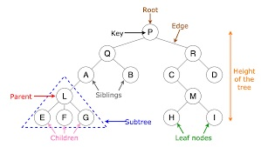

Slide 3
Definition of Tree
A tree is a finite set of one or more nodes such that:
There is a specially designated node called the root.
The remaining nodes are partitioned into n>=0 disjoint sets T1, ..., Tn, where each of these sets is a tree.
We call T1, ..., Tn the subtrees of the root.

Slide 4
Tree
Tree defined recursively
A tree is a collection of nodes. The collection can be empty; otherwise, a tree consists of a distinguished node r, called the root, and zero or more non-empty (sub) trees T₁, T₂, …, T_{k} each of whose roots are connected by a directed edge from r.
A tree is a collection of N nodes (one of which is the root) and N-1 edges.
Source:Mark Allen Weiss

Slide 5
Tree terminology
The root of each subtree is said to be a child of r and r is said to be the parent of each subtree root.
Leaves: nodes with no children (also known as external nodes)
Internal Nodes: nodes with children
Siblings: nodes with the same parent
Source:Mark Allen Weiss - edited by Evan Korth

Slide 6
Tree terminology (continued)
A path from node n₁ to n_{k} is defined as a sequence of nodes n₁, n₂, …, n_{k} such that n_{i} is the parent of n_{i+1} for 1<= i <= k.
The length of this path is the number of edges on the path namely k-1.
The length of the path from a node to itself is 0.
There is exactly one path from from the root to each node.
Source:Mark Allen Weiss

Slide 7
Tree terminology (continued)
Depth (of node): the length of the unique path from the root to a node.
Depth (of tree): The depth of a tree is equal to the depth of its deepest leaf.
Height (of node): the length of the longest path from a node to a leaf.
All leaves have a height of 0
The height of the root is equal to the depth of the tree
Source:Mark Allen Weiss

Slide 8
Level and Depth
Level
1
2
3
4
node (13)
degree of a node
leaf (terminal)
nonterminal
parent
children
sibling
degree of a tree (3)
ancestor
level of a node
height of a tree (4)
3
1
2
2
1
2
3
2
1
3
3
3
3
0
1
3
3
0
0
0
0
4
0
4
0
4

Slide 9
Terminology
The degree of a node is the number of subtrees of the node
The degree of A is 3; the degree of C is 1.
The node with degree 0 is a leaf or terminal node.
A node that has subtrees is the parent of the roots of the subtrees.
The roots of these subtrees are the children of the node.
The ancestors of a node are all the nodes along the path from the root to the node.

Slide 10
Binary Trees
A binary tree is a finite set of nodes that is either empty or consists of a root and two disjoint binary trees called the left subtree and the right subtree.
Any tree can be transformed into binary tree.
by left child-right sibling representation
The left subtree and the right subtree are distinguished.

Slide 11
A
B
E
C
G
D
K
F
H
L
M
I
J

Slide 12
Samples of Trees
Complete Binary Tree
A
A
1
A
B
B
2
B
C
C
Skewed Binary Tree
3
D
E
F
G
D
4
H
I
E
5

Slide 13
Full BT VS Complete BT
A full binary tree of depth k is a binary tree of depth k having 2 -1 nodes, k>=0.
A binary tree with n nodes and depth k is complete iff its nodes correspond to the nodes numbered from 1 to n in the full binary tree of depth k.
k
A
A
B
C
B
C
D
E
F
G
D
E
F
G
H
H
I
J
K
L
M
N
O
I
Complete binary tree
Full binary tree of depth 4

Slide 14
Binary Tree Representations
If a complete binary tree with n nodes (depth = log n + 1) is represented sequentially, then for any node with index i, 1<=i<=n, we have:
parent(i) is at i/2 if i!=1. If i=1, i is at the root and has no parent.
left_child(i) ia at 2i if 2i<=n. If 2i>n, then i has no left child.
right_child(i) ia at 2i+1 if 2i +1 <=n. If 2i +1 >n, then i has no right child.

Slide 15
Sequential Representation
[1]
[2]
[3]
[4]
[5]
[6]
[7]
[8]
[9]
A
B
C
D
E
F
G
H
I
(1) waste space
(2) insertion/deletion
problem
A
[1]
[2]
[3]
[4]
[5]
[6]
[7]
[8]
[9]
.
[16]
A
B
--
C
--
--
--
D
--
.
E
B
A
C
B
C
D
D
E
F
G
E
H
I

Slide 16
Linked Representation
public static class Node{
int data;
Node left;
Node right;
}
data
left_child
data
right_child
left_child
right_child

Slide 17
Binary Tree Traversals
Let L, V, and R stand for moving left, visiting the node, and moving right.
There are six possible combinations of traversal
LVR, LRV, VLR, VRL, RVL, RLV
Adopt convention that we traverse left before right, only 3 traversals remain
LVR, LRV, VLR
inorder, postorder, preorder

Slide 18
Arithmetic Expression Using BT
+
inorder traversal
A / B * C * D + E
infix expression
preorder traversal
+ * * / A B C D E
prefix expression
postorder traversal
A B / C * D * E +
postfix expression
level order traversal
+ * E * D / C A B
*
E
*
D
/
C
A
B

Slide 19
Inorder Traversal (recursive version)
void printInorder(Node node)
{
if (node == null)
return;
printInorder(node.left);
System.out.print(node.key + " ");
printInorder(node.right);
}
A / B * C * D + E

Slide 20
Preorder Traversal (recursive version)
void printInorder(Node node)
{
if (node == null)
return;
System.out.print(node.key + " ");
printInorder(node.left);
printInorder(node.right);
}
+ * * / A B C D E

Slide 21
Postorder Traversal (recursive version)
void printInorder(Node node)
{
if (node == null)
return;
printInorder(node.left);
printInorder(node.right);
System.out.print(node.key + " ");
}
A B / C * D * E +

Slide 22
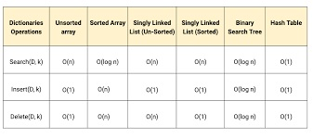
COMPARISION OF DATA STRUCTURES

Slide 23
Threaded Binary Trees
Two many null pointers in current representation of binary trees n: number of nodes number of non-null links: n-1 total links: 2n null links: 2n-(n-1)=n+1
Replace these null pointers with some useful “threads”.

Slide 24
Threaded Binary Trees (Continued)
If node.left_child is null,
replace it with a pointer to the node that would be
visited before ptr in an inorder traversal
If node.right_child is null,
replace it with a pointer to the node that would be
visited after ptr in an inorder traversal

Slide 25
A Threaded Binary Tree
root
A
dangling
B
C
dangling
D
E
F
G
inorder traversal:
H, D, I, B, E, A, F, C, G
H
I

Slide 26
Memory Representation of A Threaded BT
root
--
f
f
f
A
f
f
B
f
f
C
f
f
D
f
t
E
t
t
F
t
t
G
t
t
H
t
t
I
t

Slide 27
Heap
A max tree is a tree in which the key value in each node is no smaller than the key values in its children. A max heap is a complete binary tree that is also a max tree.
A min tree is a tree in which the key value in each node is no larger than the key values in its children. A min heap is a complete binary tree that is also a min tree.
Operations on heaps
creation of an empty heap
insertion of a new element into the heap;
deletion of the largest element from the heap

Slide 28
Sample max heaps
[1]
14
[1]
9
[1]
30
[2]
12
[3]
7
[2]
6
[3]
3
[2]
25
[4]
[5]
[6]
[4]
10
8
6
5
Property:
The root of max heap (min heap) contains
the largest (smallest).

Slide 29
Sample min heaps
[1]
2
[1]
10
[1]
11
[2]
7
[3]
4
[2]
20
[3]
83
[2]
21
[4]
[5]
[6]
[4]
10
8
6
50

Slide 30
Binary Search Tree
Heap
a min (max) element is deleted. O(log₂n)
deletion of an arbitrary element O(n)
search for an arbitrary element O(n)
Binary search tree
Every element has a unique key.
The keys in a nonempty left subtree (right subtree) are smaller (larger) than the key in the root of subtree.
The left and right subtrees are also binary search trees.

Slide 31
Binary Search Tree (BST)
Binary search trees are an important data structure for dynamic sets.
• Accomplish many dynamic-set operations in O(h) time,
where h = height of tree.
• A binary tree by a linked data structure in which each node is an object.
• root[T ] points to the root of tree T .
• Each node contains the fields
• key (and possibly other satellite data).
• left: points to left child.
• right: points to right child.
• p: points to parent. p[root[T ]] = NIL.

Slide 32


Binary Search Tree (BST)
• Stored keys must satisfy the binary-search-tree property.
• If y is in left subtree of x, then key[y] ≤ key[x].
• If y is in right subtree of x, then key[y] ≥ key[x].
$$x$$
10
$$y$$
6
16
3
9
14
19
17
(Figure: A BST on 8 nodes with height 3)

Slide 33

Binary Search Tree (BST)
• Stored keys must satisfy the binary-search-tree property.
• If y is in left subtree of x, then key[y] ≤ key[x].
• If y is in right subtree of x, then key[y] ≥ key[x].
$$x$$
10
6
16
$$y$$
3
9
14
19
17
(Figure: A BST on 8 nodes with height 3)

Slide 34
Binary Search Tree (BST)
Possible operations on BST
Traversing
Searching
Inserting
Deleting

Slide 35
Binary Search Tree (BST)
Possible operations on BST
Traversing
Searching
Inserting
Deleting

Slide 36
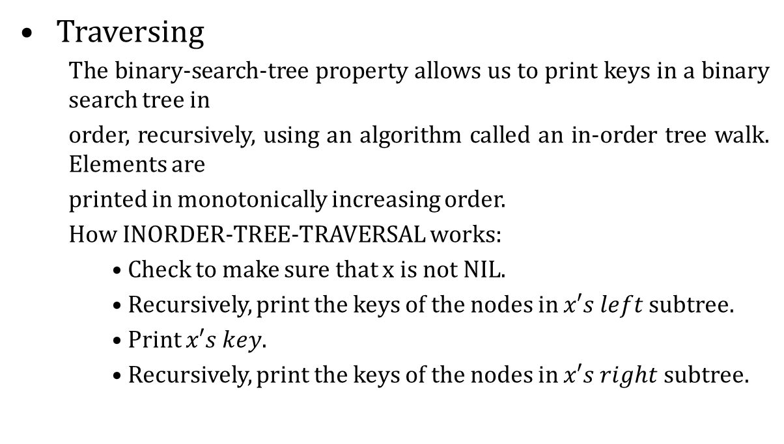
Binary Search Tree (BST)
Traversing
The binary-search-tree property allows us to print keys in a binary search tree in
order, recursively, using an algorithm called an in-order tree walk. Elements are
printed in monotonically increasing order.
How INORDER-TREE-TRAVERSAL works:
• Check to make sure that x is not NIL.
• Recursively, print the keys of the nodes in $x′s left$subtree.
• Print $x′s key$.
• Recursively, print the keys of the nodes in $x′s right$subtree.

Slide 37
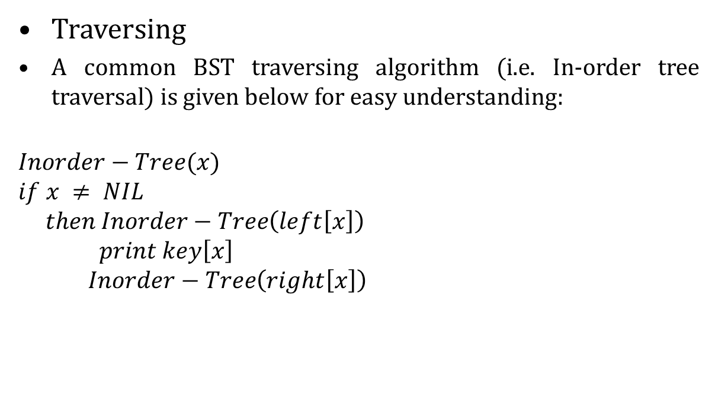
Binary Search Tree (BST)
Traversing
A common BST traversing algorithm (i.e. In-order tree traversal) is given below for easy understanding:
$$Inorder−Tree(x)$$
$$if x ≠ NIL$$
$$then Inorder−Tree\left(left\left[x\right]\right)$$
$$print key\left[x\right]$$
$$Inorder−Tree\left(right\left[x\right]\right)$$
10
6
16
3
9
14
19
17

Slide 38
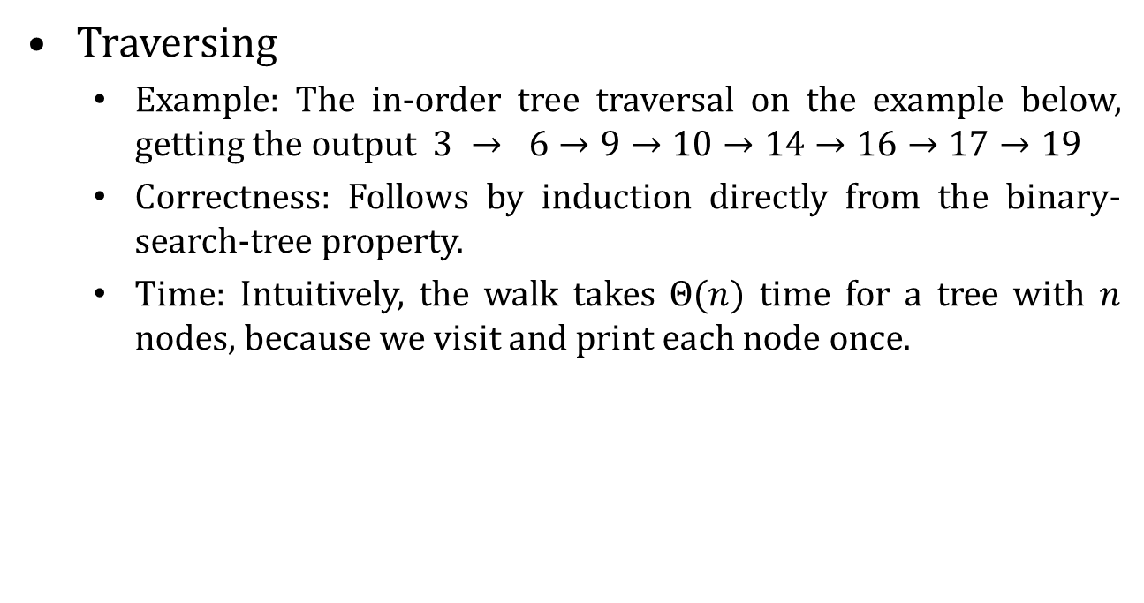
Binary Search Tree (BST)
Traversing
Example: The in-order tree traversal on the example below, getting the output $3 → 6→9→10→14→16→17→19$
Correctness: Follows by induction directly from the binary-search-tree property.
Time: Intuitively, the walk takes $Θ(n)$ time for a tree with $n$ nodes, because we visit and print each node once.
10
6
16
3
9
14
19
17

Slide 39
Binary Search Tree (BST)
Possible operations on BST
Traversing
Searching
Inserting
Deleting

Slide 40
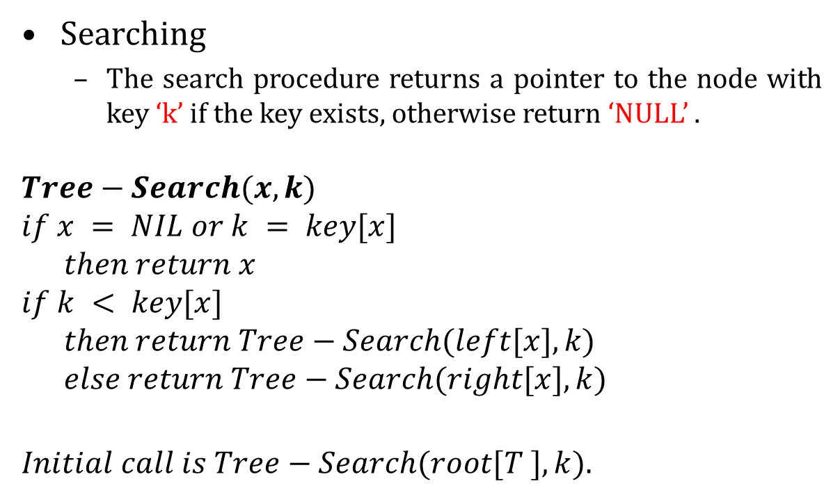
Binary Search Tree (BST)
Searching
The search procedure returns a pointer to the node with key ‘k’ if the key exists, otherwise return ‘NULL’ .
$$Tree−Search(x, k)$$
$$if x = NIL or k = key[x]$$
$$then return x$$
$$if k < key[x]$$
$$then return Tree−Search(left[x], k)$$
$$else return Tree−Search(right[x], k)$$
$$Initial call is Tree−Search(root[T ], k).$$

Slide 41
Binary Search Tree (BST)
Searching
How to search key 13 on the following Tree.
15
6
18
3
7
17
20
2
4
13
9

Slide 42
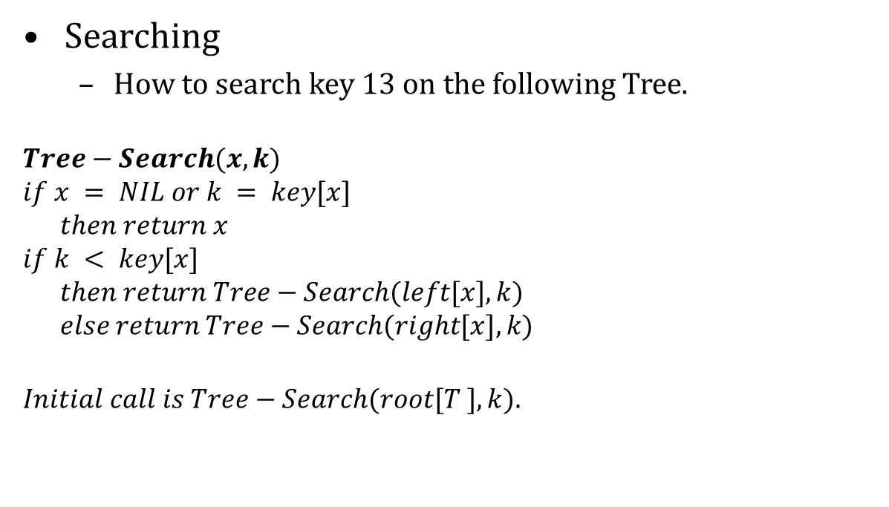
Binary Search Tree (BST)
Searching
How to search key 13 on the following Tree.
$$Tree−Search(x, k)$$
$$if x = NIL or k = key[x]$$
$$then return x$$
$$if k < key[x]$$
$$then return Tree−Search(left[x], k)$$
$$else return Tree−Search(right[x], k)$$
$$Initial call is Tree−Search(root[T ], k).$$
15
6
18
3
7
17
20
2
4
13
9

Slide 43
Binary Search Tree (BST)
Searching
How to search key 13 on the following Tree.
$$Tree−Search(x, k)$$
$$if x = NIL or k = key[x]$$
$$then return x$$
$$if k < key[x]$$
$$then return Tree−Search(left[x], k)$$
$$else return Tree−Search(right[x], k)$$
$$Initial call is Tree−Search(root[T ], k).$$
15
6
18
3
7
17
20
2
4
13
9
$$15→6→7→13$$
Time: The algorithm is recursive and visit nodes on a downward path from the root. Thus, running time is $O(h)$, where h is the height of the tree.

Slide 44
Binary Search Tree (BST)
Searching (Minimum and Maximum)
The binary-search-tree property guarantees that
• the minimum key of a binary search tree is located at the leftmost node, and
• the maximum key of a binary search tree is located at the rightmost node.
Traverse the appropriate pointers (left or right) until NIL is reached.

Slide 45
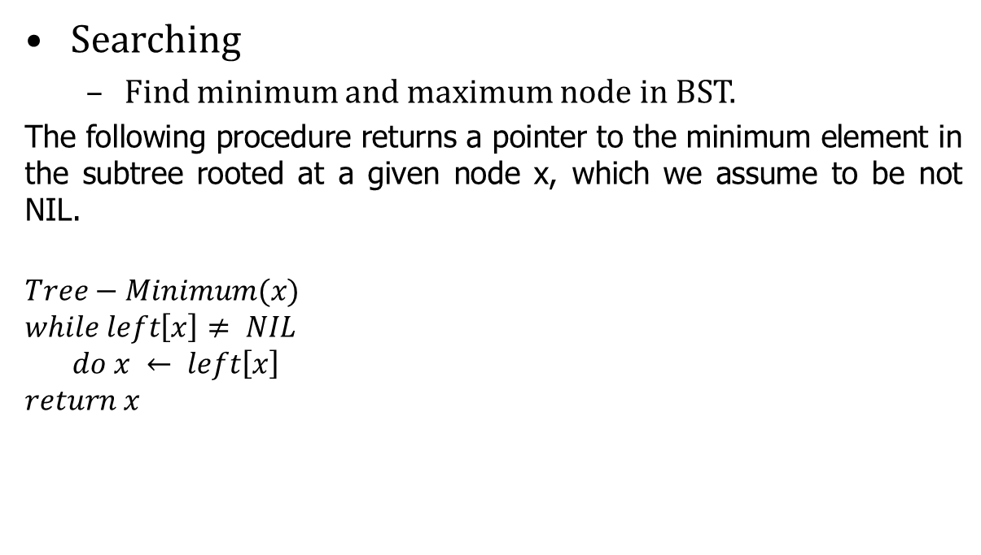
Binary Search Tree (BST)
Searching
Find minimum and maximum node in BST.
The following procedure returns a pointer to the minimum element in the subtree rooted at a given node x, which we assume to be not NIL.
$$Tree−Minimum(x)$$
$$while left\left[x\right]≠ NIL$$
$$do x ← left\left[x\right]$$
$$return x$$
15
6
18
3
7
17
20
2
4
13
9

Slide 46
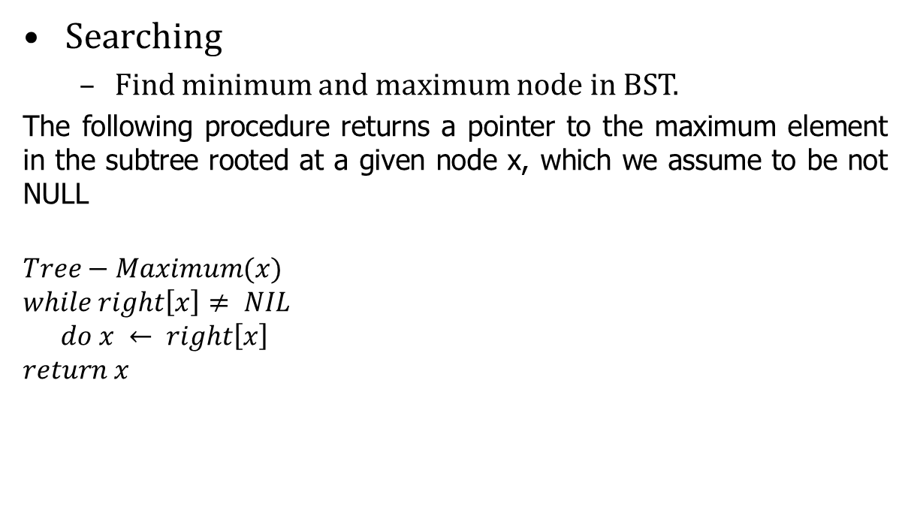
Binary Search Tree (BST)
Searching
Find minimum and maximum node in BST.
The following procedure returns a pointer to the maximum element in the subtree rooted at a given node x, which we assume to be not NULL
$$Tree−Maximum(x)$$
$$while right\left[x\right]≠ NIL$$
$$do x ← right\left[x\right]$$
$$return x$$
15
6
18
3
7
17
20
2
4
13
Time: Both procedures visit nodes that form a downward path from the root to a leaf. Both procedures run in O(h) time, where h is the height of the tree.
9

Slide 47
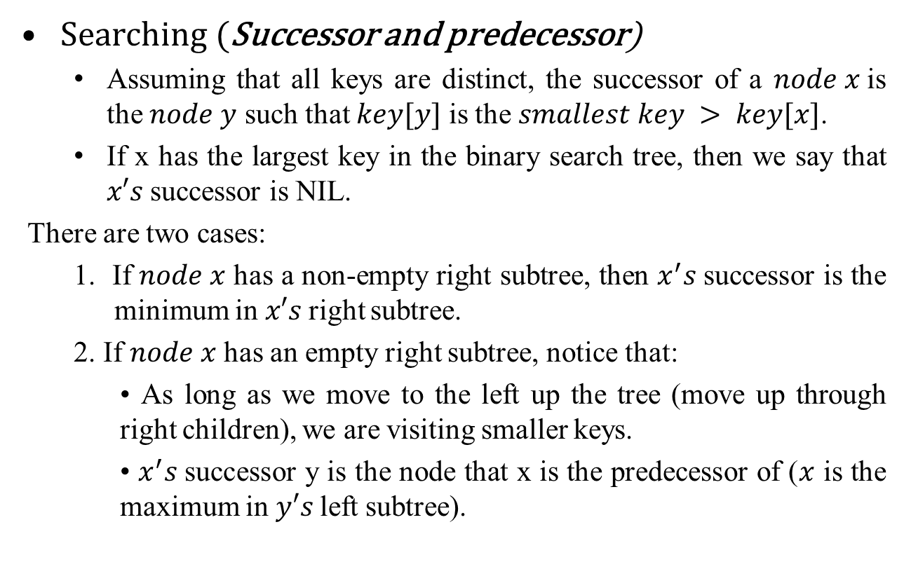
Binary Search Tree (BST)
Searching (Successor and predecessor)
Assuming that all keys are distinct, the successor of a $node x$is the $node y$ such that $key[y]$ is the $smallest key > key[x]$.
If x has the largest key in the binary search tree, then we say that $x′s$successor is NIL.
There are two cases:
1. If $node x$ has a non-empty right subtree, then $x^{′}s$successor is the minimum in $x′s$right subtree.
2. If $node x$ has an empty right subtree, notice that:
• As long as we move to the left up the tree (move up through right children), we are visiting smaller keys.
• $x^{′}s$successor y is the node that x is the predecessor of ($x$ is the maximum in $y′s$left subtree).

Slide 48
Binary Search Tree (BST)
Searching (Successor and predecessor)
Find successor node in BST.
Let us find the successor() with the help of a tree example.
Successor:
The next increased value of node x.
i.e. The successor of node 15 is 17
and
The successor of node 13 is 15
15
6
18
3
7
17
20
2
4
13
9

Slide 49
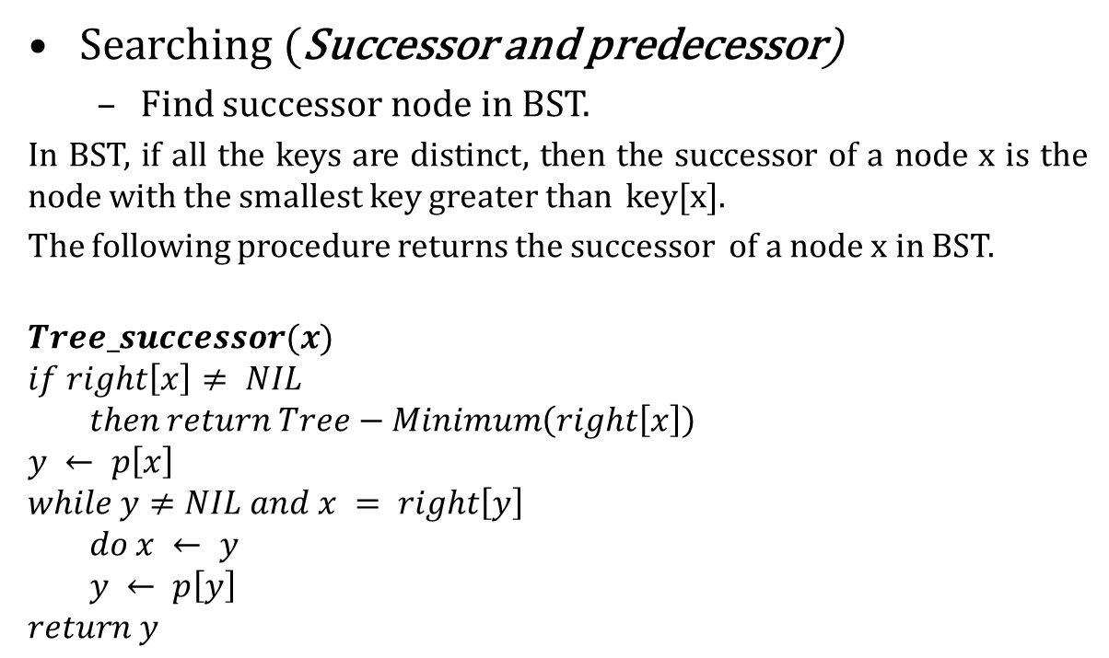
Binary Search Tree (BST)
Searching (Successor and predecessor)
Find successor node in BST.
In BST, if all the keys are distinct, then the successor of a node x is the node with the smallest key greater than key[x].
The following procedure returns the successor of a node x in BST.
$$Tree_successor(x)$$
$$if right\left[x\right]≠ NIL$$
$$then return Tree−Minimum\left(right\left[x\right]\right)$$
$$y ← p\left[x\right]$$
$$while y≠NIL and x = right\left[y\right]$$
$$do x ← y$$
$$y ← p\left[y\right]$$
$$return y$$
15
6
18
3
7
17
20
2
4
13
9

Slide 50
Binary Search Tree (BST)
Searching (Successor and predecessor)
Find predecessor node in BST.
In BST, if all the keys are distinct, then the in-order predecessor of a node x is the previous node in in-order traversal of it.
Let us find the in-order predecessor () with the help of a tree example.
For Example :
In-order predecessor of 2 do not exist.
In-order predecessor of 15 is 13
In-order predecessor of 18 is 17
15
6
18
3
7
17
20
2
4
13
9

Slide 51
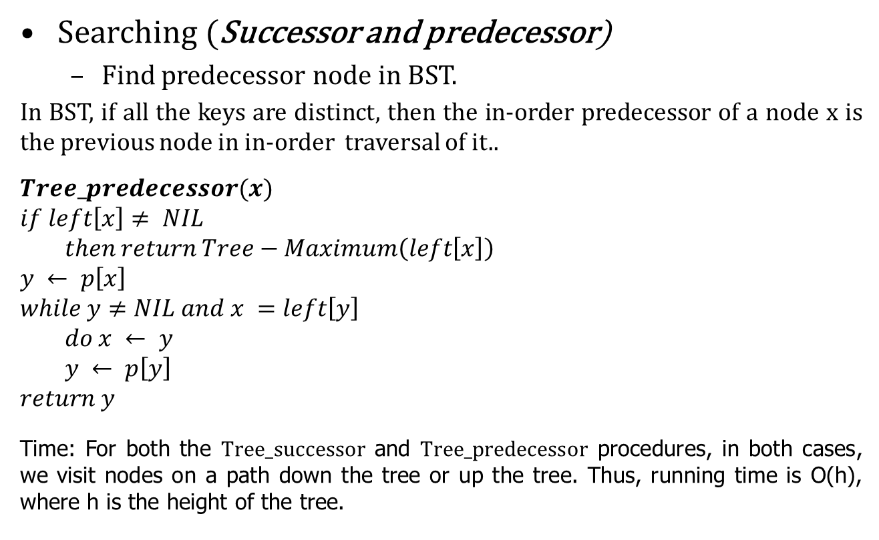
Binary Search Tree (BST)
Searching (Successor and predecessor)
Find predecessor node in BST.
In BST, if all the keys are distinct, then the in-order predecessor of a node x is the previous node in in-order traversal of it..
$$Tree_predecessor(x)$$
$$if left\left[x\right]≠ NIL$$
$$then return Tree−Maximum\left(left\left[x\right]\right)$$
$$y ← p\left[x\right]$$
$$while y≠NIL and x =left\left[y\right]$$
$$do x ← y$$
$$y ← p\left[y\right]$$
$$return y$$
Time: For both the $Tree_successor$ and $Tree_predecessor$ procedures, in both cases, we visit nodes on a path down the tree or up the tree. Thus, running time is O(h), where h is the height of the tree.
15
6
18
3
7
17
20
2
4
13
9

Slide 52
Binary Search Tree (BST)
Possible operations on BST
Traversing
Searching
Inserting
Deleting

Slide 53
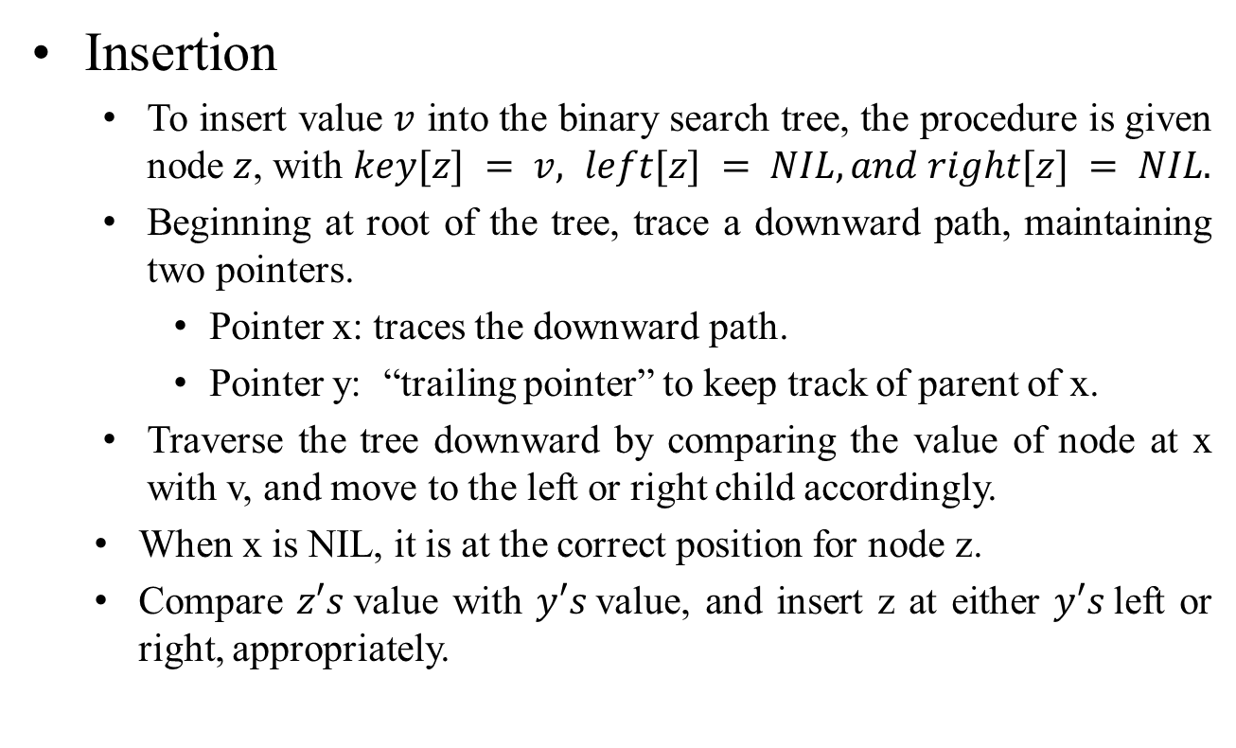
Binary Search Tree (BST)
Insertion
To insert value $v$ into the binary search tree, the procedure is given node $z$, with $key[z] = v, left[z] = NIL, and right[z] = NIL.$
Beginning at root of the tree, trace a downward path, maintaining two pointers.
Pointer x: traces the downward path.
Pointer y: “trailing pointer” to keep track of parent of x.
Traverse the tree downward by comparing the value of node at x with v, and move to the left or right child accordingly.
When x is NIL, it is at the correct position for node z.
Compare $z′s$value with $y′s$value, and insert z at either $y′s$left or right, appropriately.

Slide 54
Binary Search Tree (BST)
Insertion
Example: insert 14
15
6
18
3
7
17
20
2
4
13
9

Slide 55
Binary Search Tree (BST)
Insertion
Example: insert 14
15
15
6
18
6
18
3
7
17
20
3
7
17
20
2
4
13
2
4
13
9
14
9

Slide 56

Binary Search Tree (BST)
Insertion
15
$$Tree−Insert(T, z)$$
$$y ← NIL$$
$$x ← root[T ]$$
$$while x ≠ NIL$$
$$do y ← x$$
$if key[z] < key[x]$
$then x ← left[x]$
$else$
$x ← right[x]$
$$p[z] ← y$$
$$if y = NIL$$
$$then root\left[T \right]←z⊳ Tree T was empty$$
$$else if key[z] < key[y]$$
$$then left[y] ← z$$
$$else$$
$right[y] ← z$
6
18
3
7
17
20
2
4
13
9
14

Slide 57
Binary Search Tree (BST)
Insertion (Time complexity)
Same as Tree-Search() . On a tree of height h, procedure takes O(h) time.
Tree-Insert() can be used with Inorder-Tree() to sort a given set of numbers.
15
6
18
3
7
17
20
2
4
13
9
14

Slide 58
Binary Search Tree (BST)
Possible operations on BST
Traversing
Searching
Inserting
Deleting

Slide 59
Binary Search Tree (BST)
Deletion
TREE-DELETE is broken into three cases.
Case 1: node z has no children.
Delete node z by making the parent of z point to NULL, instead of to z.
Case 2: node z has one child.
Delete z by making the parent of z point to z.s child, instead of to z.
Case 3: z has two children.
node z’s successor y has either no children or one child. (y is the minimum node.with no left child.in z.s right subtree.)
Delete y from the tree (via Case 1 or 2).
Replace z.s key and satellite data with y.s.

Slide 60
Binary Search Tree (BST)
Deletion
TREE-DELETE is broken into three cases.
Case 1: node z has no children.
Delete node z by making the parent of z point to NULL, instead of to z.
Example: Delete 14
15
6
18
3
7
17
20
2
4
13
9
14

Slide 61
Binary Search Tree (BST)
Deletion
Case 1: node z has no children.
Delete node z by making the parent of z point to NULL, instead of to z.
Example: Delete 14
15
15
6
18
6
18
3
7
17
20
3
7
17
20
2
4
13
2
4
13
9
14
Deletion of node 14 done successfully
9
Before deletion
14
After deletion

Slide 62
Binary Search Tree (BST)
Deletion
Case 2: node z has one child.
Delete z by making the parent of z point to z.s child, instead of to z.
Example: Delete node 13
15
6
18
3
7
17
20
2
4
13
9

Slide 63
Binary Search Tree (BST)
Deletion
Case 2: node z has one child.
Delete z by making the parent of z point to z.s child, instead of to z.
Example: Delete node 13
15
15
6
18
6
18
3
7
17
20
3
7
17
20
2
4
13
2
4
13
9
Deletion of node 13 done successfully
9
Before deletion
After deletion

Slide 64
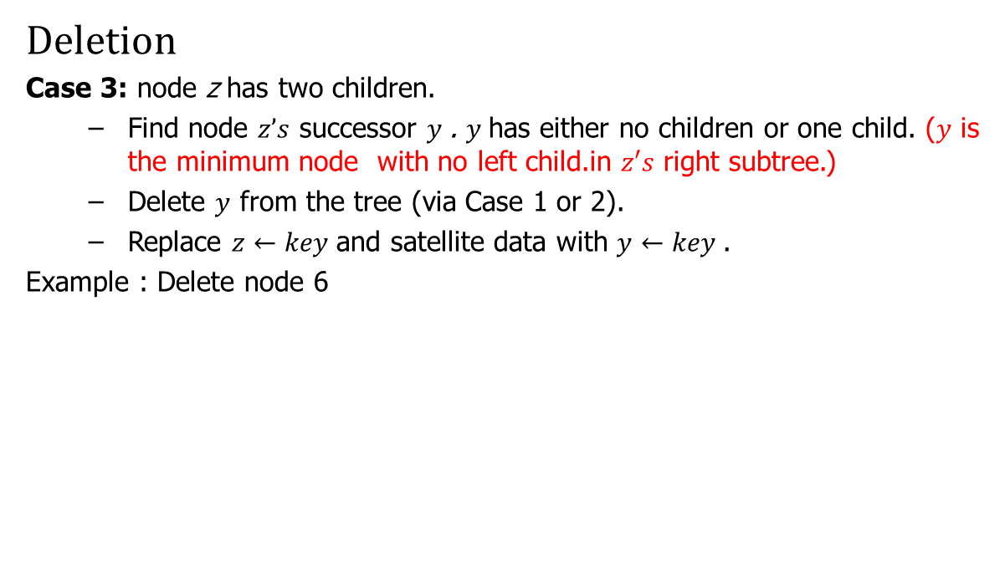
Binary Search Tree (BST)
Deletion
Case 3: node z has two children.
Find node $z’s$ successor $y$. $y$has either no children or one child. ($y$ is the minimum node with no left child.in $z′s$ right subtree.)
Delete $y$ from the tree (via Case 1 or 2).
Replace $z←key$and satellite data with $y←key$.
Example : Delete node 6
15
6
18
3
7
17
20
2
4
9

Slide 65
Binary Search Tree (BST)
Deletion
Case 3: node z has two children.
Find node $z’s$ successor $y$. $y$has either no children or one child. ($y$ is the minimum node with no left child.in $z′s$ right subtree.)
Delete $y$ from the tree (via Case 1 or 2).
Replace $z←key$and satellite data with $y←key$.
Example : Delete node 6
15
6
18
3
7
17
20
2
4
9
In-order successor of node 6

Slide 66
Binary Search Tree (BST)
Deletion
Case 3: node z has two children.
Find node $z’s$ successor $y$. $y$has either no children or one child. ($y$ is the minimum node with no left child.in $z′s$ right subtree.)
Delete $y$ from the tree (via Case 1 or 2).
Replace $z←key$and satellite data with $y←key$.
Example : Delete node 6
15
15
7
18
6
18
3
9
17
20
3
7
17
20
2
4
2
4
9
In-order successor of node 6
6
Deletion of node 6 done successfully

Slide 67
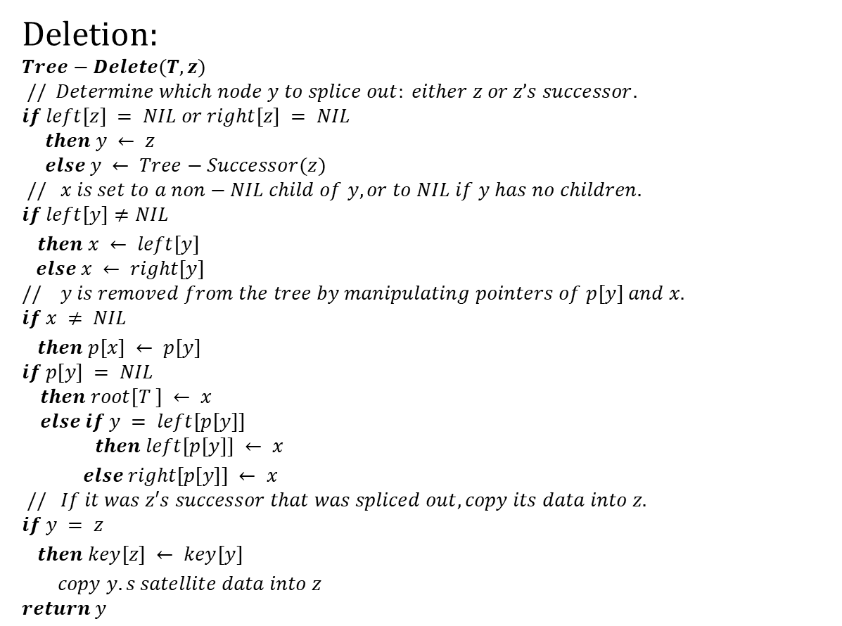
Binary Search Tree (BST)
Deletion:
$$Tree−Delete(T, z)$$
$$// Determine which node y to splice out: either z or z’s successor.$$
$$if left[z] = NIL or right[z] = NIL$$
$$then y ← z$$
$$else y ← Tree−Successor(z)$$
$$// x is set to a non−NIL child of y, or to NIL if y has no children.$$
$$if left[y]≠NIL$$
$then x ← left[y]$
$$else x ← right[y]$$
$$// y is removed from the tree by manipulating pointers of p[y] and x.$$
$$if x ≠ NIL$$
$then p[x] ← p[y]$
$$if p[y] = NIL$$
$$then root[T ] ← x$$
$$else if y = left[p[y]]$$
$$then left[p[y]] ← x$$
$else right[p[y]] ← x$
$$// If it was z′s successor that was spliced out, copy its data into z.$$
$$if y = z$$
$then key[z] ← key[y]$
$copy y.s satellite data into z$
$$return y$$

Slide 68
Binary Search Tree (BST)
Deletion:
$$Tree−Delete(T, z)$$
$$// Determine which node y to splice out: either z or z’s successor.$$
$$if left[z] = NIL or right[z] = NIL$$
$$then y ← z$$
$$else y ← Tree−Successor(z)$$
$$// x is set to a non−NIL child of y, or to NIL if y has no children.$$
$$if left[y]≠NIL$$
$then x ← left[y]$
$$else x ← right[y]$$
$$// y is removed from the tree by manipulating pointers of p[y] and x.$$
$$if x ≠ NIL$$
$then p[x] ← p[y]$
$$if p[y] = NIL$$
$$then root[T ] ← x$$
$$else if y = left[p[y]]$$
$$then left[p[y]] ← x$$
$else right[p[y]] ← x$
$$// If it was z′s successor that was spliced out, copy its data into z.$$
$$if y = z$$
$then key[z] ← key[y]$
$copy y.s satellite data into z$
$$return y$$
Time: O(h), on a tree of height h.

Slide 69
AVL Trees

Slide 70
Binary Search Tree - Best Time
All BST operations are O(d), where d is tree depth
minimum d is for a binary tree with N nodes
What is the best case tree?
What is the worst case tree?
So, best case running time of BST operations is O(log N)

Slide 71
Binary Search Tree - Worst Time
Worst case running time is O(N)
What happens when you Insert elements in ascending order?
Insert: 2, 4, 6, 8, 10, 12 into an empty BST
Problem: Lack of “balance”:
compare depths of left and right subtree
Unbalanced degenerate tree

Slide 72
Balanced and unbalanced BST
1
4
2
2
5
3
1
3
4
4
Is this “balanced”?
5
2
6
6
1
3
5
7
7

Slide 73
Approaches to balancing trees
Don't balance
May end up with some nodes very deep
Strict balance
The tree must always be balanced perfectly
Pretty good balance
Only allow a little out of balance
Adjust on access
Self-adjusting

Slide 74
Balancing Binary Search Trees
Many algorithms exist for keeping binary search trees balanced
Adelson-Velskii and Landis (AVL) trees (height-balanced trees)
Splay trees and other self-adjusting trees
B-trees and other multiway search trees

Slide 75
Perfect Balance
Want a complete tree after every operation
tree is full except possibly in the lower right
This is expensive
For example, insert 2 in the tree on the left and then rebuild as a complete tree
6
5
Insert 2 &
complete tree
4
9
2
8
1
5
8
1
4
6
9

Slide 76
AVL - Good but not Perfect Balance
AVL trees are height-balanced binary search trees
Balance factor of a node
height(left subtree) - height(right subtree)
An AVL tree has balance factor calculated at every node
For every node, heights of left and right subtree can differ by no more than 1
Store current heights in each node

Slide 77
Node Heights
Tree A (AVL)
Tree B (AVL)
height=2 BF=1-0=1
2
6
6
1
0
1
1
4
9
4
9
0
0
0
0
0
1
5
1
5
8
height of node = h
balance factor = h_{left}-h_{right}
empty height = -1

Slide 78
Node Heights after Insert 7
Tree A (AVL)
Tree B (not AVL)
2
3
balance factor
1-(-1) = 2
6
6
1
1
1
2
4
9
4
9
0
0
0
0
0
1
-1
1
5
7
1
5
8
0
7
height of node = h
balance factor = h_{left}-h_{right}
empty height = -1

Slide 79
Insert and Rotation in AVL Trees
Insert operation may cause balance factor to become 2 or –2 for some node
only nodes on the path from insertion point to root node have possibly changed in height
So after the Insert, go back up to the root node by node, updating heights
If a new balance factor (the difference h_{left}-h_{right}) is 2 or –2, adjust tree by rotation around the node

Slide 80
Single Rotation in an AVL Tree
2
2
6
6
1
2
1
1
4
9
4
8
0
0
1
0
0
0
0
1
5
8
1
5
7
9
0
7

Slide 81
Insertions in AVL Trees
Let the node that needs rebalancing be α.
There are 4 cases:
Outside Cases (require single rotation) :
1. Insertion into left subtree of left child of α.
2. Insertion into right subtree of right child of α.
Inside Cases (require double rotation) :
3. Insertion into right subtree of left child of α.
4. Insertion into left subtree of right child of α.
The rebalancing is performed through four separate rotation algorithms.

Slide 82
AVL Insertion: Outside Case
j
Consider a valid
AVL subtree
k
h
Z
h
h
X
Y

Slide 83
AVL Insertion: Outside Case
j
Inserting into X
destroys the AVL
property at node j
k
h
Z
h+1
h
Y
X

Slide 84
AVL Insertion: Outside Case
j
Do a “right rotation”
k
h
Z
h+1
h
Y
X

Slide 85
Single right rotation
j
Do a “right rotation”
k
h
Z
h+1
h
Y
X

Slide 86
Outside Case Completed
k
“Right rotation” done!
(“Left rotation” is mirror
symmetric)
j
h+1
h
h
X
Y
Z
AVL property has been restored!

Slide 87
AVL Insertion: Inside Case
j
Consider a valid
AVL subtree
k
h
Z
h
h
X
Y

Slide 88
AVL Insertion: Inside Case
Inserting into Y
destroys the
AVL property
at node j
j
Does “right rotation”
restore balance?
k
h
Z
h
h+1
X
Y

Slide 89
AVL Insertion: Inside Case
k
“Right rotation”
does not restore
balance… now k is
out of balance
j
h
X
h
h+1
Z
Y

Slide 90
AVL Insertion: Inside Case
Consider the structure
of subtree Y…
j
k
h
Z
h
h+1
X
Y

Slide 91
AVL Insertion: Inside Case
j
Y = node i and
subtrees V and W
k
h
Z
i
h
h+1
X
h or h-1
V
W

Slide 92
AVL Insertion: Inside Case
j
We will do a left-right
“double rotation” . . .
k
Z
i
X
V
W

Slide 93
Double rotation : first rotation
j
left rotation complete
i
Z
k
W
V
X

Slide 94
Double rotation : second rotation
j
Now do a right rotation
i
Z
k
W
V
X

Slide 95
Double rotation : second rotation
right rotation complete
Balance has been
restored
i
k
j
h
h
h or h-1
V
X
W
Z

Slide 96
Insertion in AVL Trees
Insert at the leaf (as for all BST)
only nodes on the path from insertion point to root node have possibly changed in height
So after the Insert, go back up to the root node by node, updating heights
If a new balance factor (the difference h_{left}-h_{right}) is 2 or –2, adjust tree by rotation around the node

Slide 97
Example of Insertions in an AVL Tree
2
20
Insert 5, 40
0
1
10
30
0
0
25
35

Slide 98
Example of Insertions in an AVL Tree
2
3
20
20
1
1
1
2
10
30
10
30
0
0
0
1
0
0
5
25
35
5
25
35
0
40
Now Insert 45

Slide 99
Single rotation (outside case)
3
3
20
20
1
2
1
2
10
30
10
30
0
0
2
0
0
5
25
35
5
25
40
1
0
0
35
45
1
40
Imbalance
0
45
Now Insert 34

Slide 100
Double rotation (inside case)
3
3
20
20
1
3
1
2
10
30
10
35
0
0
2
0
1
5
Imbalance
25
40
5
30
40
1
0
1
0
25
34
45
35
45
0
Insertion of 34
0
34

Slide 101
AVL Tree Deletion
Similar but more complex than insertion
Rotations and double rotations needed to rebalance
Imbalance may propagate upward so that many rotations may be needed.

Slide 102
Pros and Cons of AVL Trees
Arguments for AVL trees:
Search is O(log N) since AVL trees are always balanced.
Insertion and deletions are also O(logn)
The height balancing adds no more than a constant factor to the speed of insertion.
Arguments against using AVL trees:
Difficult to program & debug; more space for balance factor.
Asymptotically faster but rebalancing costs time.
Most large searches are done in database systems on disk and use other structures (e.g. B-trees).
May be OK to have O(N) for a single operation if total run time for many consecutive operations is fast (e.g. Splay trees).

Slide 103
Q: The sequence of number is in inorder.
4, 10, 12, 15, 18, 22, 24, 31, 35, 44, 50, 66, 70, 90.
Covert the given inorder sequence to preorder and postorder.
Draw the tree structure for the same.

Slide 104
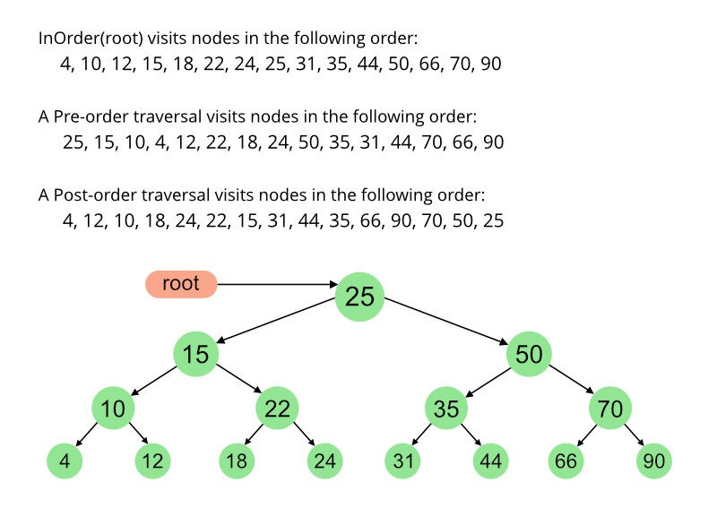

Slide 105
B-trees and B+ trees

Slide 106
Motivation
To have dynamic indexing structures that can evolve when records are added and deleted
Not the case for static indexes
Would have to be completely rebuilt
Optimized for searches on block devices
Both B trees and B+ trees are not binary
Objective is to increase branching factor (degree or fan-out) to reduce the number of device accesses

Slide 107
Binary vs. higher-order tree
Binary trees:
Designed for in-memory searches
Try to minimize the number of memory accesses
Higher-order trees:
Designed for searching data on block devices
Try to minimize the number of device accesses
Searching within a block is cheap!

Slide 108
B trees
Generalization of binary search trees
Not binary trees
The B stands for Bayer (or Boeing)
Designed for searching data stored on block-oriented devices

Slide 109
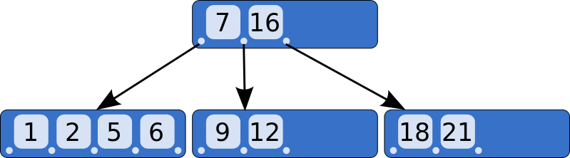
A very small B tree
Bottom nodes are leaf nodes: all their pointers are NULL

Slide 110
In reality
In tree ptr
Key
In tree ptr
Key
In tree ptr
Key
In tree ptr
Key
In tree ptr
Data ptr
Data ptr
Data ptr
Data ptr
To
Leaf
7
To leaf
16
To
Leaf
--
Null
--
Null
Null
Null

Slide 111
Organization
Each non-terminal node can have a variable number of child nodes
Must all be in a specific key range
Number of child nodes typically vary between d and 2d
Will split nodes that would otherwise have contained 2d + 1 child nodes
Will merge nodes that contain less than d child nodes

Slide 112
Searching the tree
keys < 7
keys > 16
7 < keys < 16

Slide 113
Balancing B trees
Objective is to ensure that all terminals nodes be at the same depth

Slide 114
Insertions
Assume a tree where each node can contain three pointers (non represented)
Step 1:
Step 2:
Step 3:
Split node in middle
1
1
2
1
2
3
2
1
3

Slide 115
Insertions
Step 4:
Step 5:
Split
Move up
2
1
3
4
2
1
3
4
5
2
4
1
3
5

Slide 116
Insertions
Step 6:
Step 7:
2
4
1
3
5
6
2
4
1
3
5
6
7

Slide 117
Step 7 continued
2
4
Split
Promote
1
3
6
4
7
2
4
6
1
3
5
7

Slide 118
Step 7 continued
Split after the promotion
2
4
6
1
3
5
7
4
2
6
1
3
5
7

Slide 119
Two basic operations
5
6
7
Split:
When trying to add to a full node
Split node at central value
Promote:
Must insert root of split node higher up
May require a new split
6
5
7

Slide 120
B+ trees
Variant of B trees
Two types of nodes
Internal nodes have no data pointers
Leaf nodes have no in-tree pointers
Were all null!

Slide 121
B+ tree nodes
In tree ptr
Key
In tree ptr
Key
In tree ptr
Key
In tree ptr
Key
In tree ptr
Key
In tree ptr
Key
Key
Key
Key
Key
Key
Data ptr
Data ptr
Data ptr
Data ptr
Data ptr
Data ptr

Slide 122
More about internal nodes
Consist of n -1 key values K₁, K₂, …, K_{n-1} ,and n tree pointers P₁, P₂, …, P_{n} :
< P₁,K₁, P₂, K₂, P₃, …, P_{n-1}, K_{n-1,}, P_{n}>
The keys are ordered K₁ < K₂ < … < K_{n-1}
For each tree value X in the subtree pointed at by tree pointer P_{i}, we have:
X > K_{i-1} for 1 ≤ i ≤ n
X ≤ K_{i} for 1 ≤ i ≤ n - 1

Slide 123
Warning
Other authors assume that
For each tree value X in the subtree pointed at by tree pointer P_{i}, we have:
X ≥ K_{i-1} for 1 ≤ i ≤ n
X < K_{i} for 1 ≤ i ≤ n - 1
Changes the key value that is promoted when an internal node is split

Slide 124
Advantages
Removing unneeded pointers allows to pack more keys in each node
Higher fan-out for a given node size
Normally one block
Having all keys present in the leaf nodes allows us to build a linked list of all keys

Slide 125
Properties
If m is the order of the tree
Every internal node has at most m children.
Every internal node (except root) has at least ⌈m ⁄ 2⌉ children.
The root has at least two children if it is not a leaf node.
Every leaf has at most m − 1 keys
An internal node with k children has k − 1 keys.
All leaves appear in the same level

Slide 126
Best cases and worst cases
A B+ tree of degree m and height h will store
At most m^{h – 1}(m – 1) = m^{h} – m records
At least 2⌈m ⁄ 2⌉^{h – 1} records

Slide 127
Insertions
Assume a B+ tree of degree 3
Step 1:
Step 2:
Step 3:
Split node in middle
1
1
2
1
2
3
2
1
2
3

Slide 128
Insertions
Step 4:
Step 5:
Split
Move up
2
1
2
3
4
2
1
2
3
4
5
2
4
1
2
3
4
5

Slide 129
Insertions
Step 6:
Step 7:
2
4
1
2
3
4
5
6
2
4
1
2
3
4
5
6
7

Slide 130
Step 7 continued
2
4
Split
Promote
1
2
3
4
6
5
6
7
2
4
6
1
2
3
4
5
6
7

Slide 131
Step 7 continued
Split after the promotion
2
4
6
1
3
5
7
4
2
6
1
3
5
7

Slide 132
Importance
B+ trees are used by
NTFS, ReiserFS, NSS, XFS, JFS, ReFS, and BFS file systems for metadata indexing
BFS for storing directories.
IBM DB2, Informix, Microsoft SQL Server, Oracle 8, Sybase ASE, and SQLite for table indexes

Slide 133
Hashing

Slide 134
Fundamentals
Define m target addresses (the "buckets")
Create a hash function h(k) that is defined for all possible values of the key k and returns an integer value h such that 0 ≤ h ≤ m – 1
h(k)
Key

Slide 135

The idea
Key
Hash value is Bucket address

Slide 136
Bucket sizes
Each bucket consists of one or more blocks
Need some way to convert the hash value into a logical block address
Selecting large buckets means we will have to search the contents of the target bucket to find the desired record
If search time is critical and the database infrequently updated, we should consider sorting the records inside each bucket

Slide 137
Bucket organization
Two possible solutions
Buckets contain records
When bucket is full, records go to an overflow bucket
Buckets contain pairs <key, address>
When bucket is full, pairs <key, address> go to an overflow bucket

Slide 138
Buckets contain records
Assume each
bucket contains
two records
Overflow bucket

Slide 139
Buckets contain records
A record
KEY
A bucket can
contain many
more keys
than records
Many more
records
KEY

Slide 140
Finding a good hash function
Should distribute records evenly among the buckets
A bad hash function will have too many overflowing buckets and too many empty or near-empty buckets

Slide 141
A good starting point
If the key is numeric
Divide the key by the number of buckets
If the number of buckets is a power of two, this means selecting log₂ m least significant bits of key
Otherwise
Transform the key into a numerical value
Divide that value by the number of buckets

Slide 142
Looking further
Hashing works best when the number of buckets is a prime number
If performance matters, consult
Donald Knuth's Art of Computer Programming
http://en.wikipedia.org/wiki/Hash_function

Slide 143
Selecting the load factor
Percentage of used slots
Best range is between 0.5 and 0.8
If load factor < 0.5
Too much space is wasted
If load factor > 0.8
Bucket overflows start becoming a problem
Depending on how evenly the hash function distributes the keys among the buckets

Slide 144
Dynamic hashing
Conventional hashing techniques work well when the maximum number of records is known ahead of time
Dynamic hashing lets the hash table grow as the number of records grow
Two techniques:
Extendible hashing
Linear hashing

Slide 145
Extendible hashing
Represent hash values as bit strings:
100101, 001001, …
Introduce an additional level of indirection, the directory
One entry per key value
Multiple entries can point to the same bucket

Slide 146
Extendible hashing
We assume a three-bit key
Directory
K = 010
Records with key = 0*
000
d = 1
001
010
K = 111
Records with key = 1*
001
d = 1
100
101
110
Both buckets are at same depth d
101

Slide 147
Extendible hashing
When a bucket overflows, we split it
Directory
K = 000
Records with key = 00*
d = 2
000
001
010
K = 111
Records with key = 1*
d = 1
001
100
101
Records with key = 01*
K = 010
d = 2
110
K = 011
101

Slide 148
Explanations (I)
Choice of a bucket is based on the most significant bits (MSBs) of hash value
Start with a single bit
Will have two buckets
One for MSB = 0
Other for MSB = 1
Depth of bucket is 1

Slide 149
Explanations (II)
Each time a bucket overflows, we split it
Assume first bucket overflows
Will add a new bucket containing records with MSBs of hash value = 01
Older bucket will keep records with MSBs of hash value = 00
Depths of these two bucket is 2

Slide 150
Explanations (III)
At any given time, the hash table will contain buckets at different depths
In our example, buckets 00 and 01 are at depth 2 while bucket 1 is at depth 1
Each bucket will include a record of its depth
Just a few bits

Slide 151
Discussion
Extendible hashing
Allows hash table contents
To grow, by splitting buckets
To shrink by merging buckets
but
Adds one level of indirection
No problem if the directory can reside in main memory

Slide 152
Linear hashing
Does not add an additional level of indirection
Reduces but does not eliminate overflow buckets
Uses a family of hash functions
h_{i}(K) = K mod m
h_{i+1}(K) = K mod 2m
h_{i+2}(K) = K mod 4m
…

Slide 153
How it works (I)
Start with
m buckets
h_{i}(K) = K mod m
When any bucket overflows
Create an overflow bucket
Create a new bucket at location m
Apply hash function h_{i+1}(K)= K mod 2m to the contents of bucket 0
Will now be split between buckets 0 and m

Slide 154
How it works (II)
When a second bucket overflows
Create an overflow bucket
Create a new bucket at location m + 1
Apply hash function h_{i+1}(K)= K mod 2m to the contents of bucket 1
Will now be split between buckets 1 and m + 1

Slide 155
How it works (III)
Each time a bucket overflows
Create an overflow bucket
Apply hash function h_{i+1}(K)= K mod 2m to the contents of the successor s + 1 of the last bucket that was split
Contents of bucket s + 1 will now be split between buckets s and m + s – 1
The size of the hash table grows linearly at each split until all buckets use the new hash function

Slide 156
Advantages
The hash table goes linearly
As we split buckets in linear order, bookkeeping is very simple:
Need only to keep track of the last bucket s that was split
Buckets 0 to s use the new hash function h_{i+1}(K)= K mod 2m
Buckets s + 1 to m – 1 still use the old hash function h_{i}(K)= K mod m

Slide 157
Example (I)
Assume m = 4 and one record per bucket
Table contains two records
Hash value = 0
Hash value = 2

Slide 158
Example (II)
We add one record with hash value = 2
Overflow bucket
Hash value = 2
Hash value = 2
New bucket
Hash value = 4
We assume that the contents of bucket 0 were migrated to bucket 4

